Slide 1
Welcome
to
An IIMB Alumni venture in Early Childhood Education
12th Annual day Celebration
25-3-2025

Slide 2
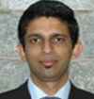
Management Team
Mr.Guruprasad comes from a family, which has been in real estate for the last 15 years. Having worked for various Fortune-100 companies, he vows to bring in transparency and structure into real-estate industry using his inherent knowledge about this market. He is an Executive MBA from IIM Bangalore & B.E from RV College Bangalore.

Slide 3
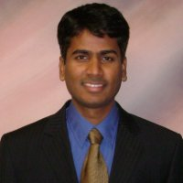
Mr. Suresh Raghavendra works as an MBA consultant helping candidates through profile building, application/essay review, interview preparation, and GMAT coaching. Experienced in running businesses in real estate and early childhood education sectors. Experienced in managing operations, forging alliances with preferred partners; developing new revenue channels Specialties: Education, E-learning, Startups in education, Operations, business development, project/program management, public works infrastructure
He is an MBA from IIM Bangalore and an MS from Arizona State University

Slide 4
About us
“Good kindergarten education can spell success in adulthood having a major impact on earning potential" -Raj Chetty, Harvard Professor
Our objective is to promote New Vistas Kids as the best preschool and daycare in Bangalore and to develop an enthusiasm for learning in kids that will spell future success in life.

Slide 5
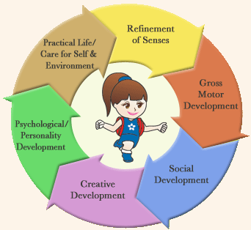
Our Mission
We don't just teach, we inspire them to learn the right way, We encourage them to aim sky-high in a fun-filled, secure, and supportive environment. Miracles happen when small things are addressed , not forced.
Our Vision
Every child acquires good life skills in the initial formative years. We facilitate an all-round development of mind, body and soul in these crucial formative years through an integrated curriculum and heartfelt importance for value based education.

Slide 6
Our Philosophy
Every child is unique and they develop at a different pace.
Child centered environment through self exploration and a variety of play to learn activities.
Early establishment of the positive self-concept and a positive attitude towards the school provides a foundation for formal education.
We train the kids in which character is formed, strength of mind is increased, the intellect is expanded and one can stand on one's own feet.

Slide 7
We offer the Pre-School Regular Programs
The age of the child at the time of Admission should be as specified under.
Class | Age Group
Play Group | 1½ Year - 2½ Year
Nursery | 2½ Year - 3½ Year
LKG | 3½ Year - 4½ Year
UKG | 4½ Year - 5½ Year
We offer the Day Care Programs
Infant & Toddler Program For children below 2 years Extended Pre-School Day Program (After School Care) For children from our pre-school Post School Day Program (After School Care) For children from other schools

Slide 8
Our Achievements
Our students who graduated last year got admission in reputed institutions such as National Public School, HSR Layout, Delhi Public School, South, Ryan International School, Kundalahalli
Successfully completed Summer camp in arts, drama and craft class

Slide 9
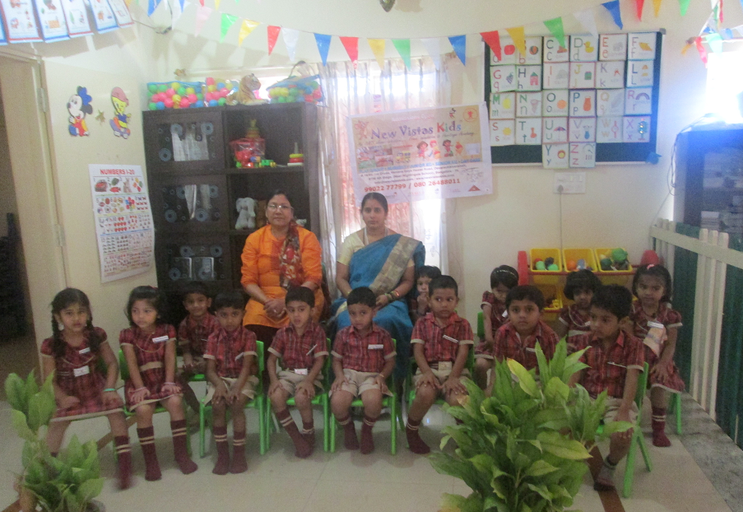
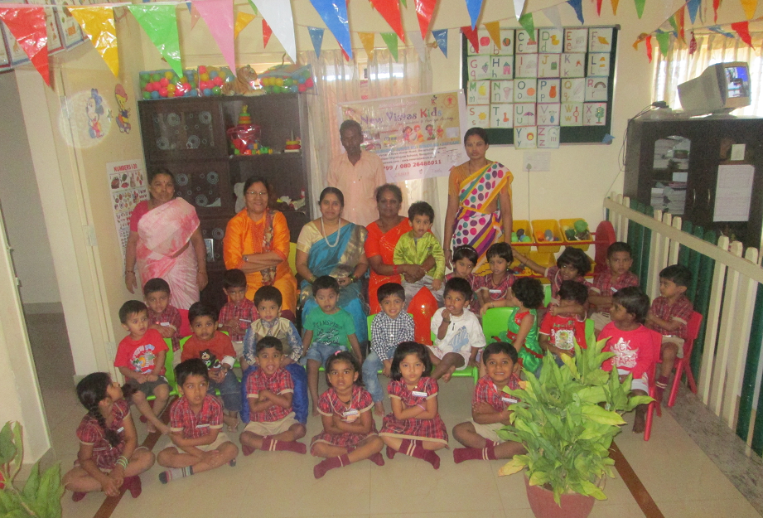
Facilitators
Friendly, warm, caring and child friendly teachers with rich experience in teaching
Patient and understanding nannies who go the extra mile to help the kids
Vigilant security for the premises is provided by our guards
In house transportation is provided for pick up and drop of kids for the convenience of the parents

Slide 10
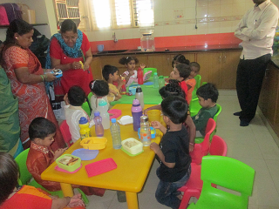
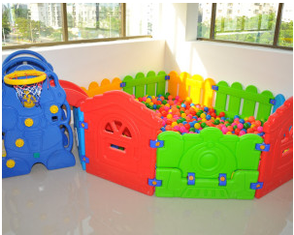
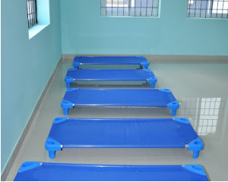
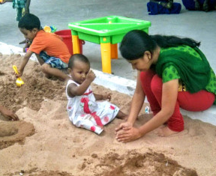
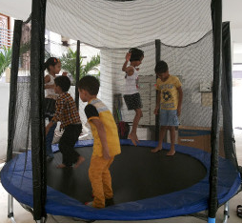
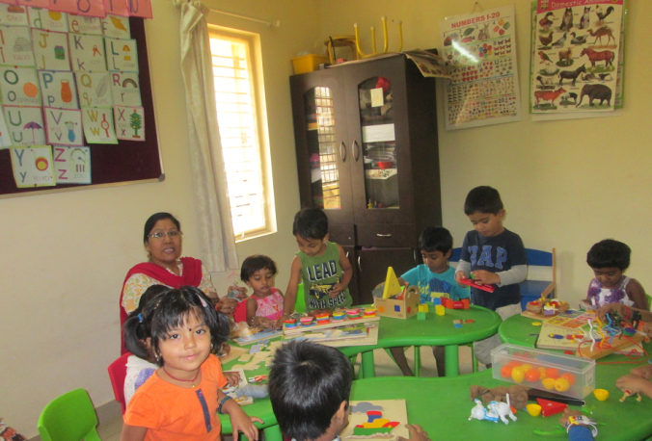
Facilities
Our schools are located in quiet localities, Partaking, No dust Pollution, and no sound Pollution .our Classrooms have spacious, bright and inviting. comfortable furnishings to create a calm and welcoming environment. The furniture is colorful sturdy and of a child’s height without any sharp edges.
Library Corner, Show Time, Arts & Crafts, Play Area, Role Play Corner etc that are well resourced in order to attract children. Needless to say, all our facilities are aesthetically designed and kept in sparkling clean conditions.

Slide 11
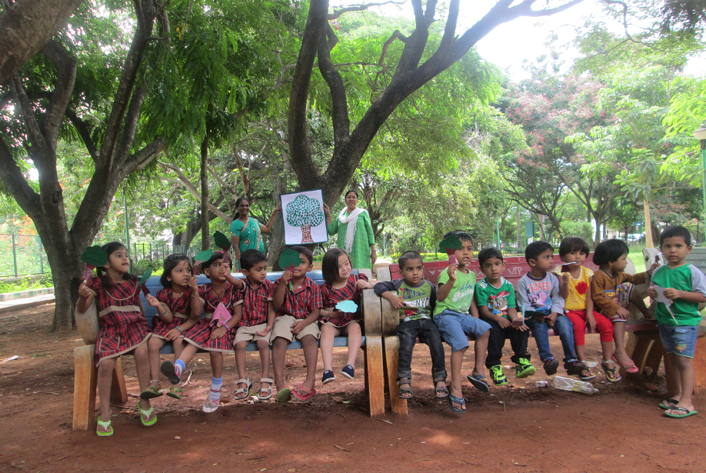
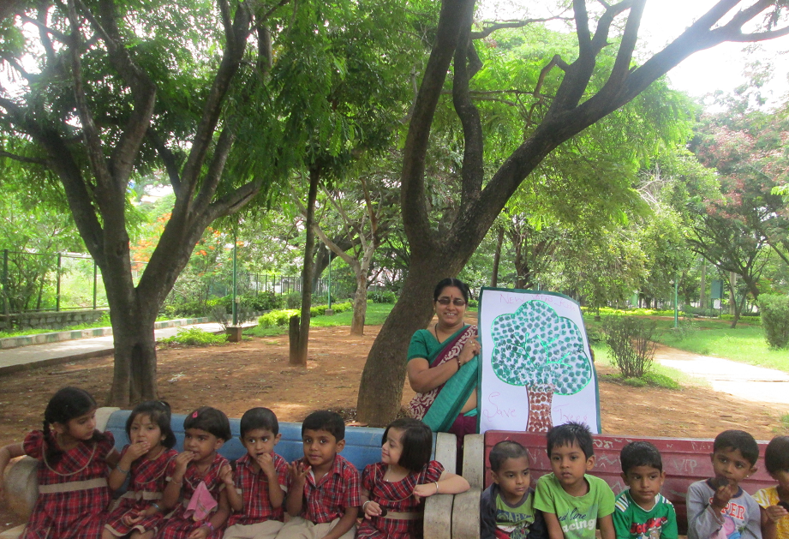
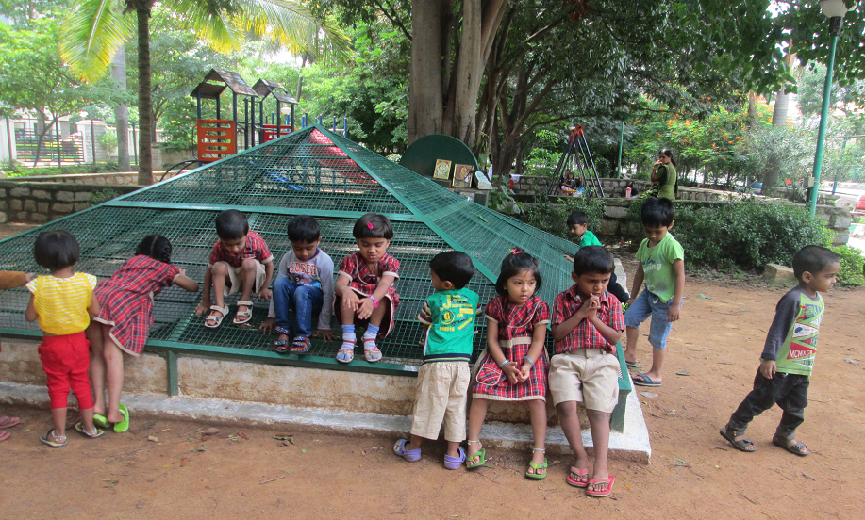
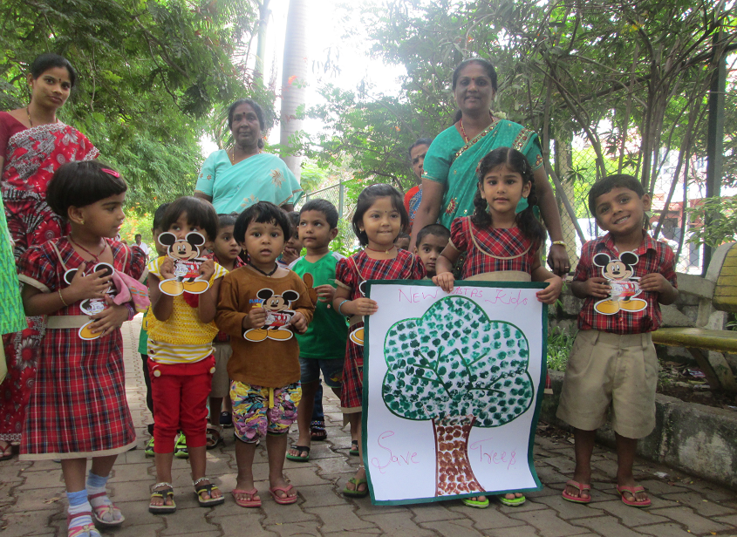
Green Day Celebration

Slide 12
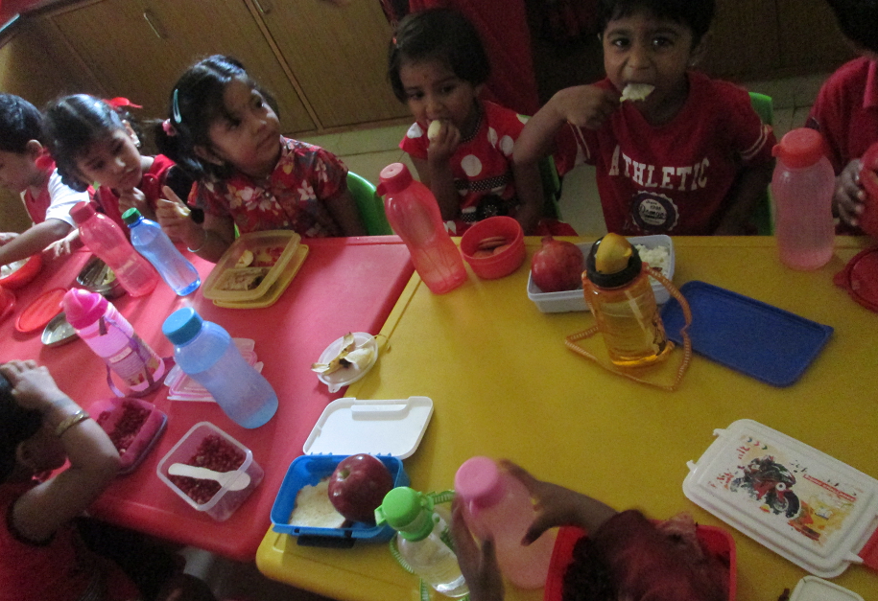
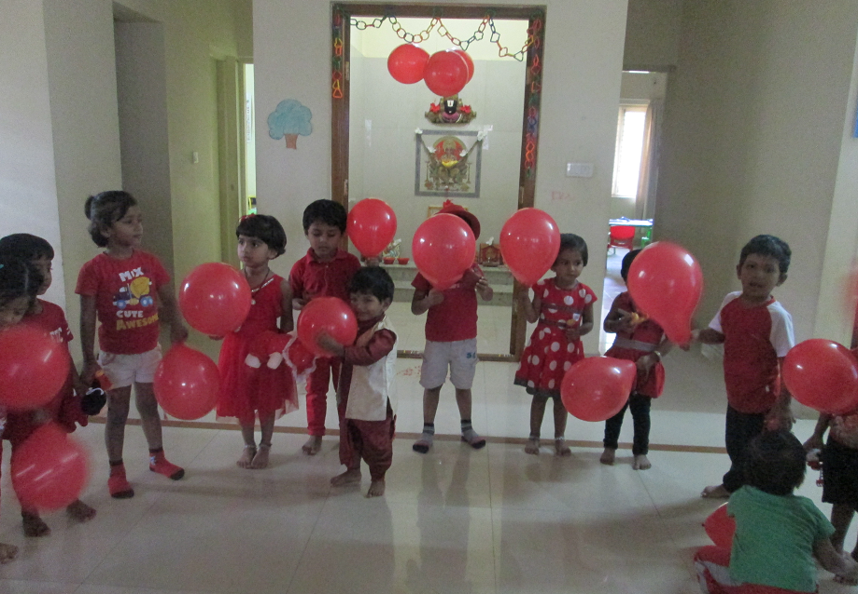
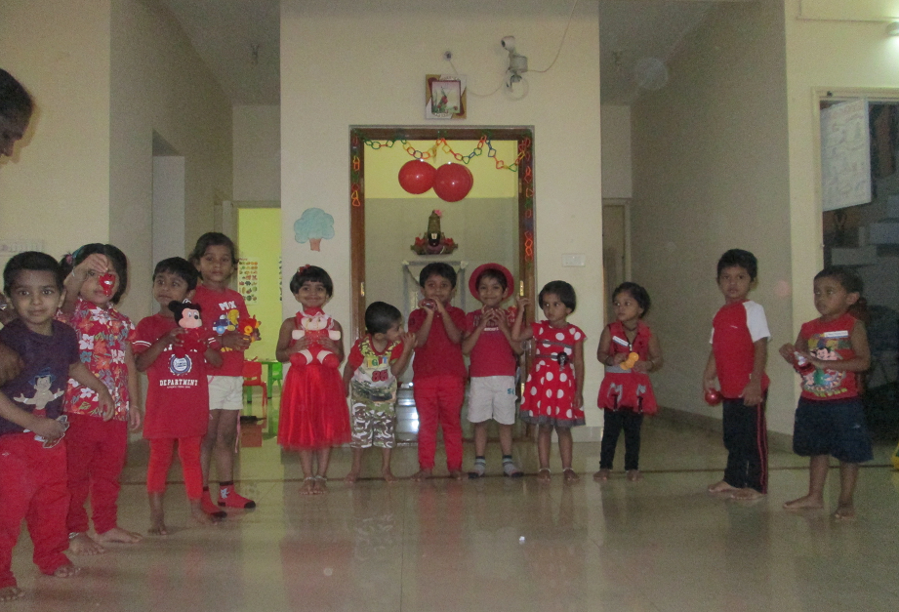
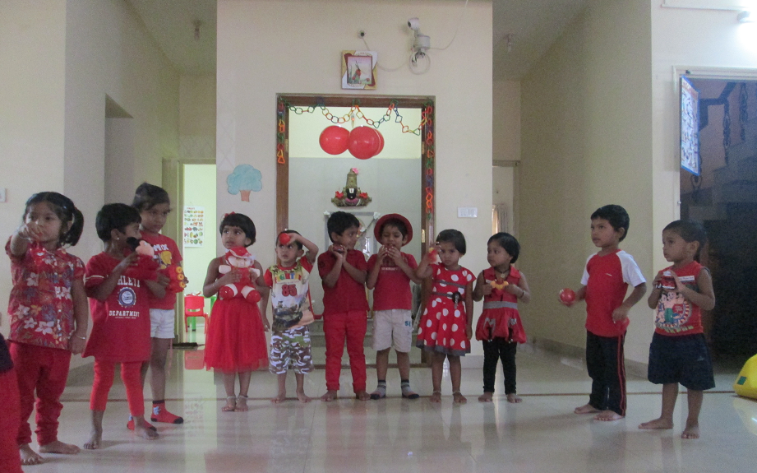
Red Day Celebration

Slide 13
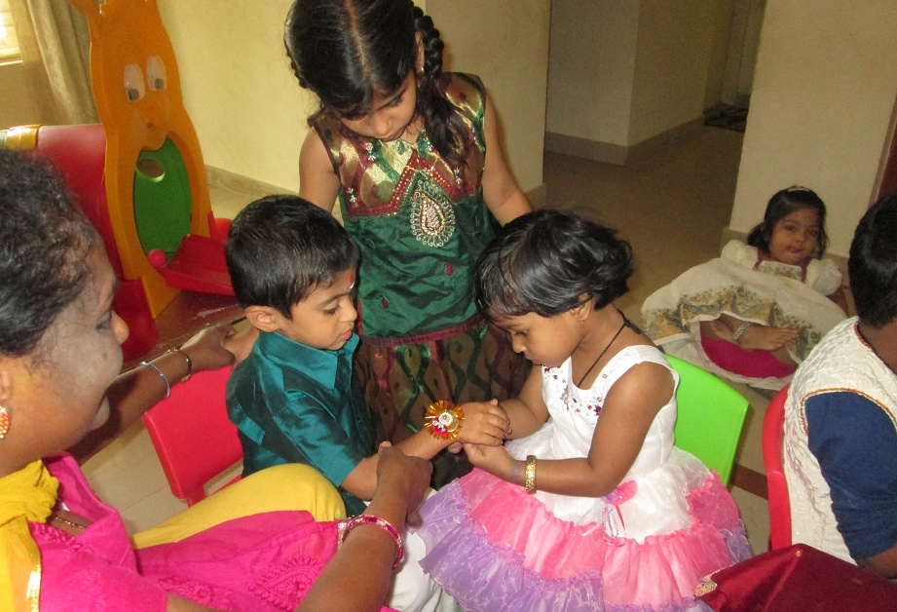
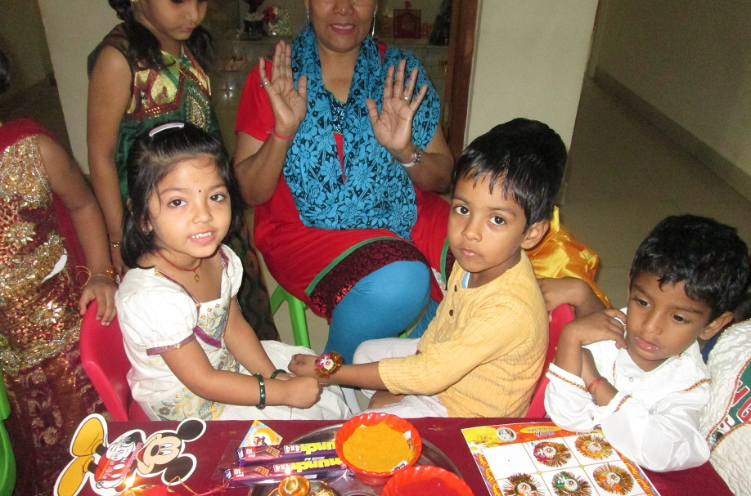
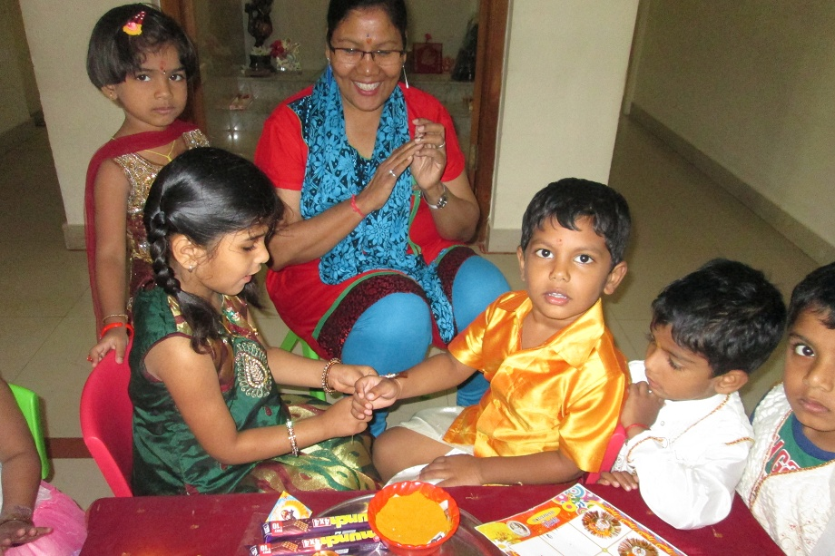
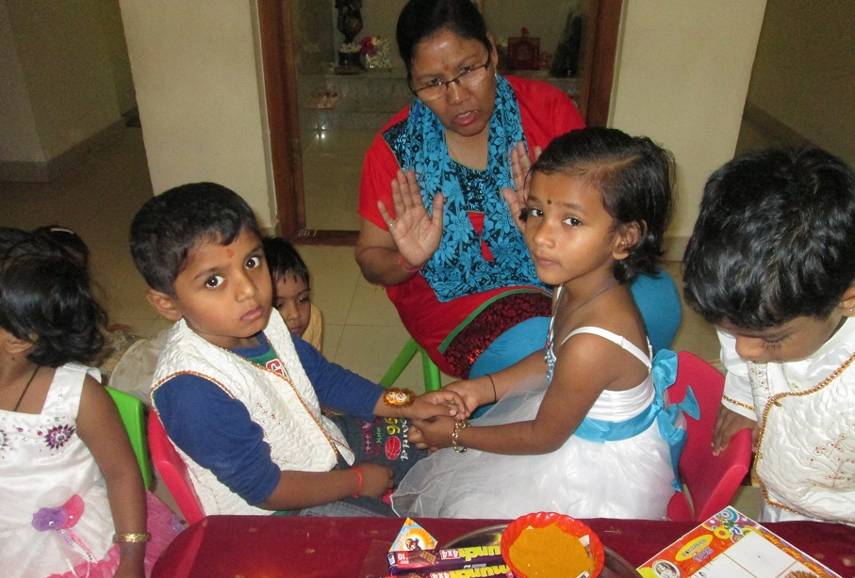
Rakhi Celebration

Slide 14
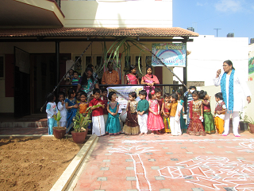
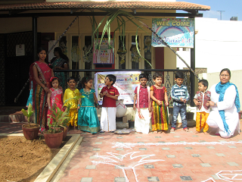
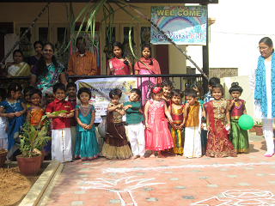
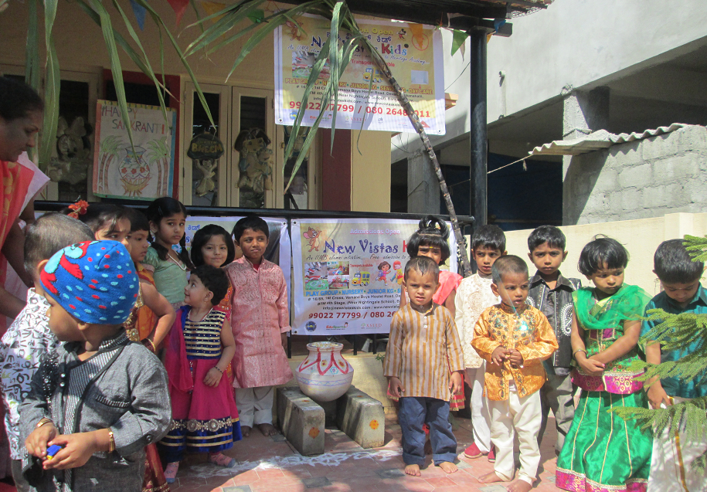
Sankranthi Celebration

Slide 15
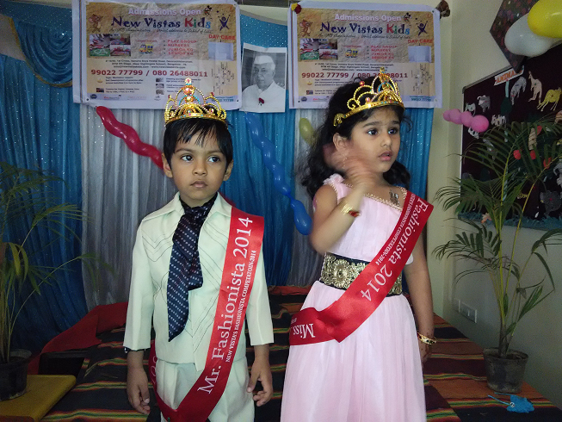
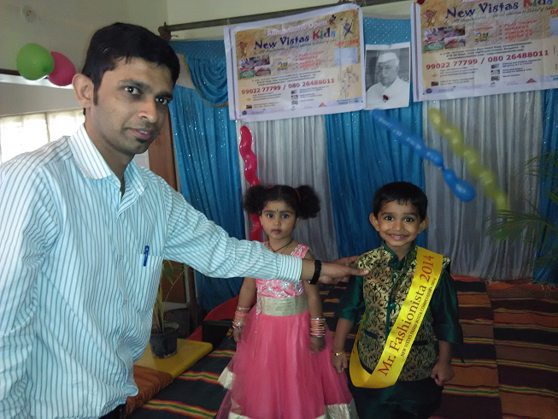
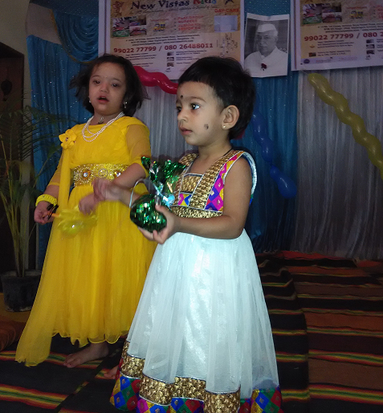
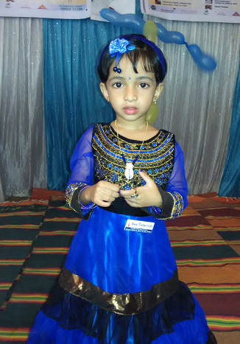
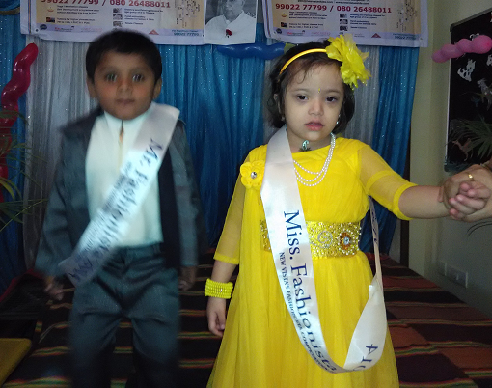
Children's Day Celebration

Slide 16
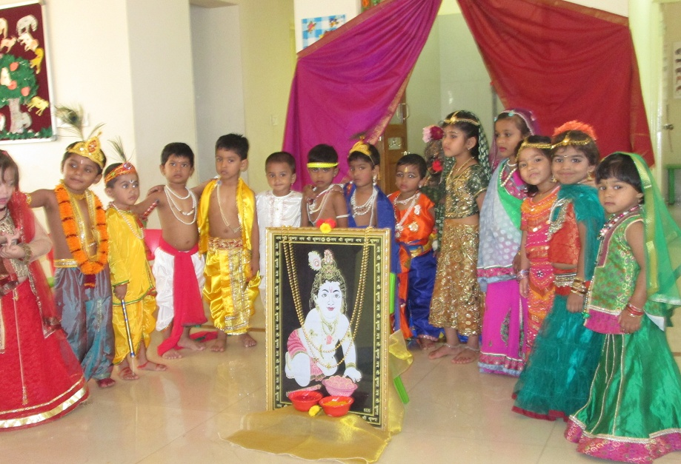
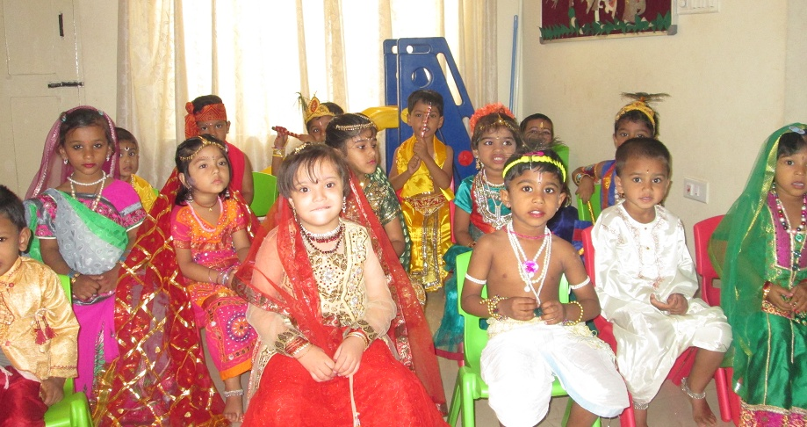
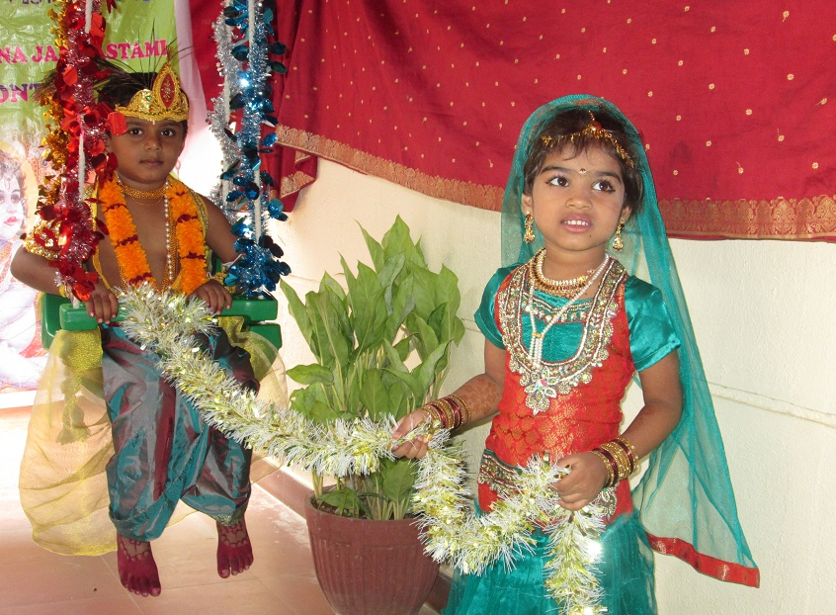
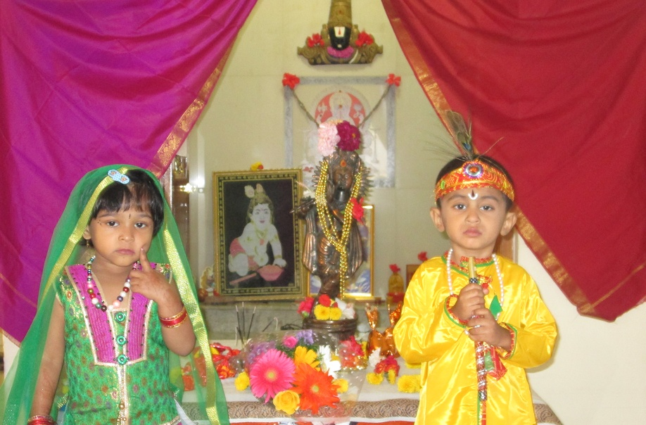
Krishnastmi Celebration

Slide 17
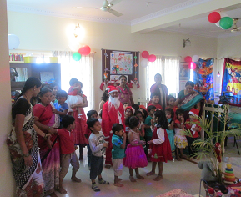
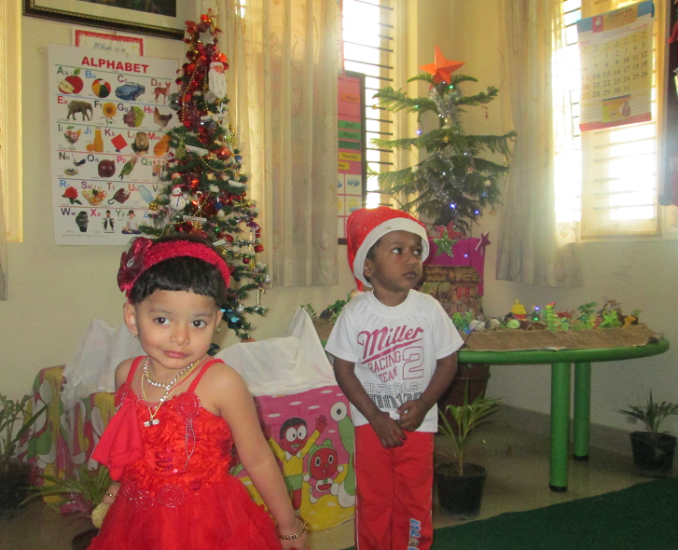
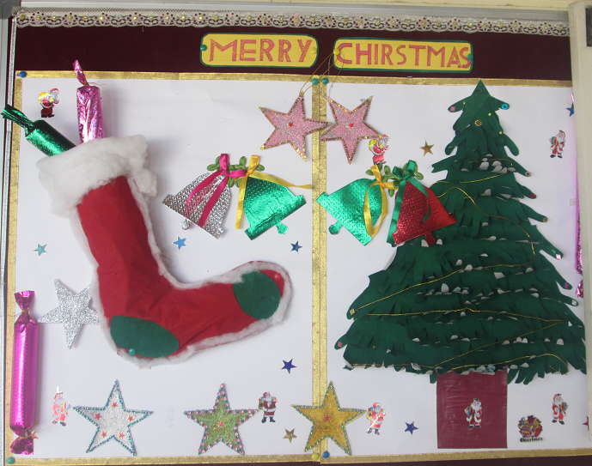
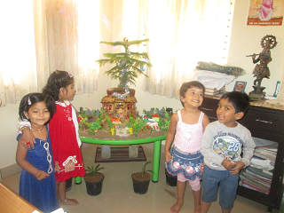
Christmas Day Celebration

Slide 18
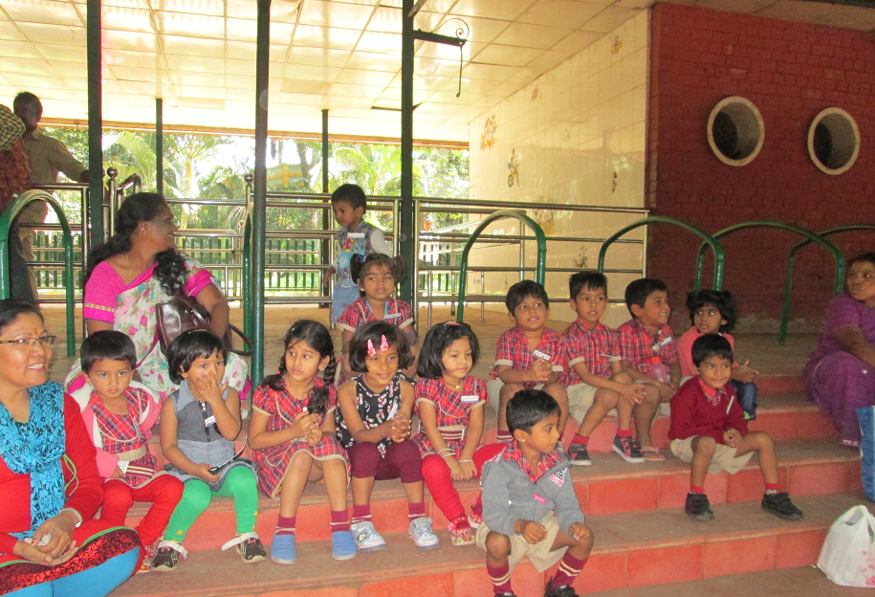
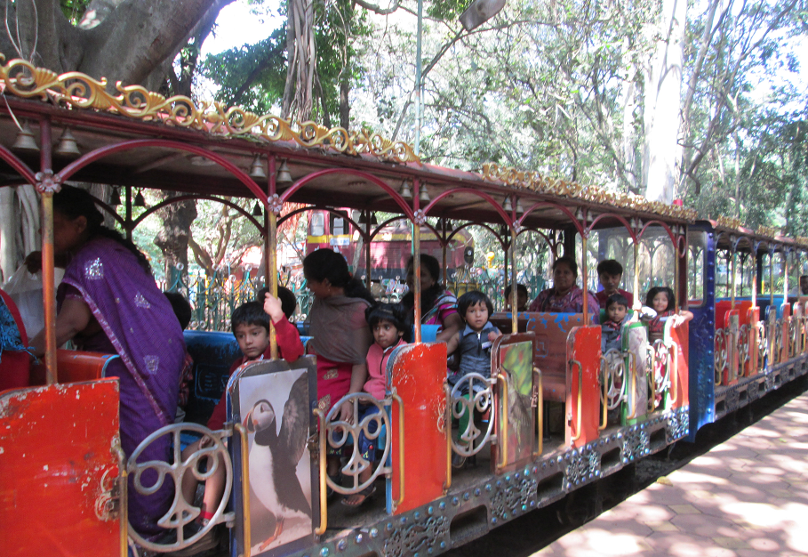
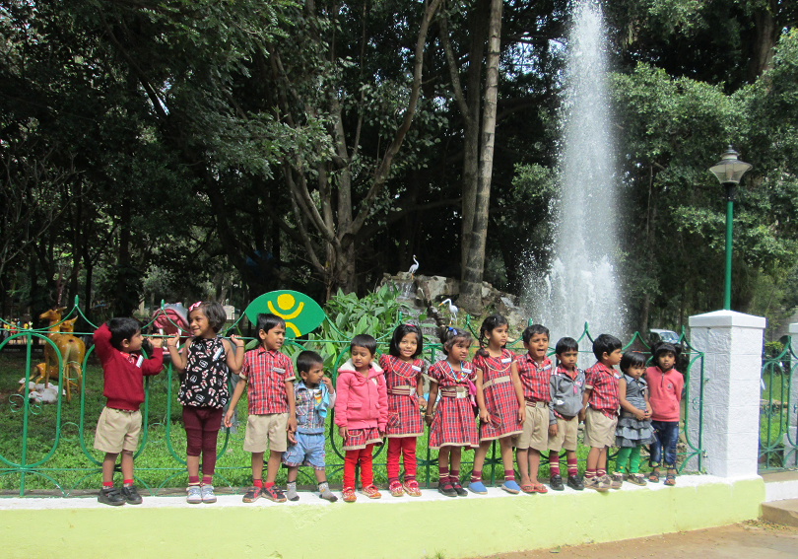
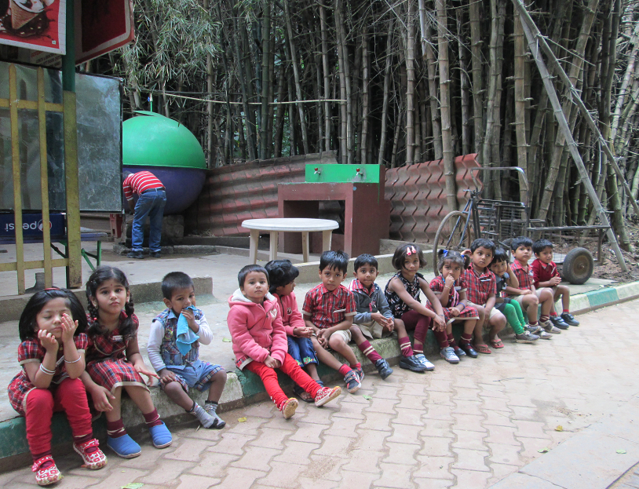
Outing-Cubbon park Trip

